Slide 1

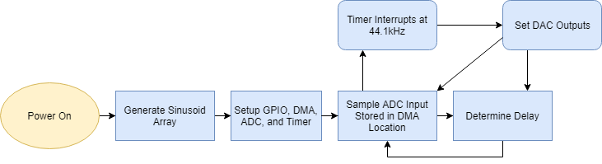
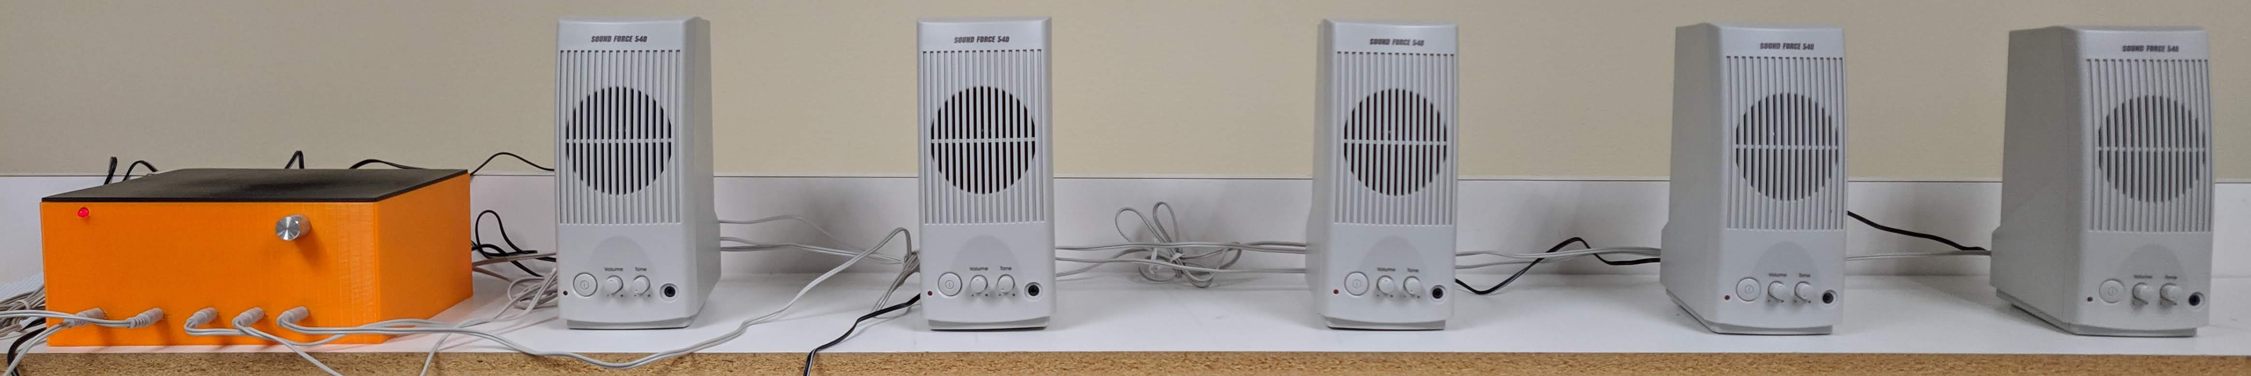
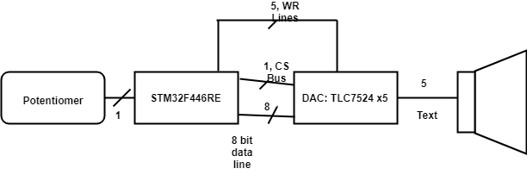
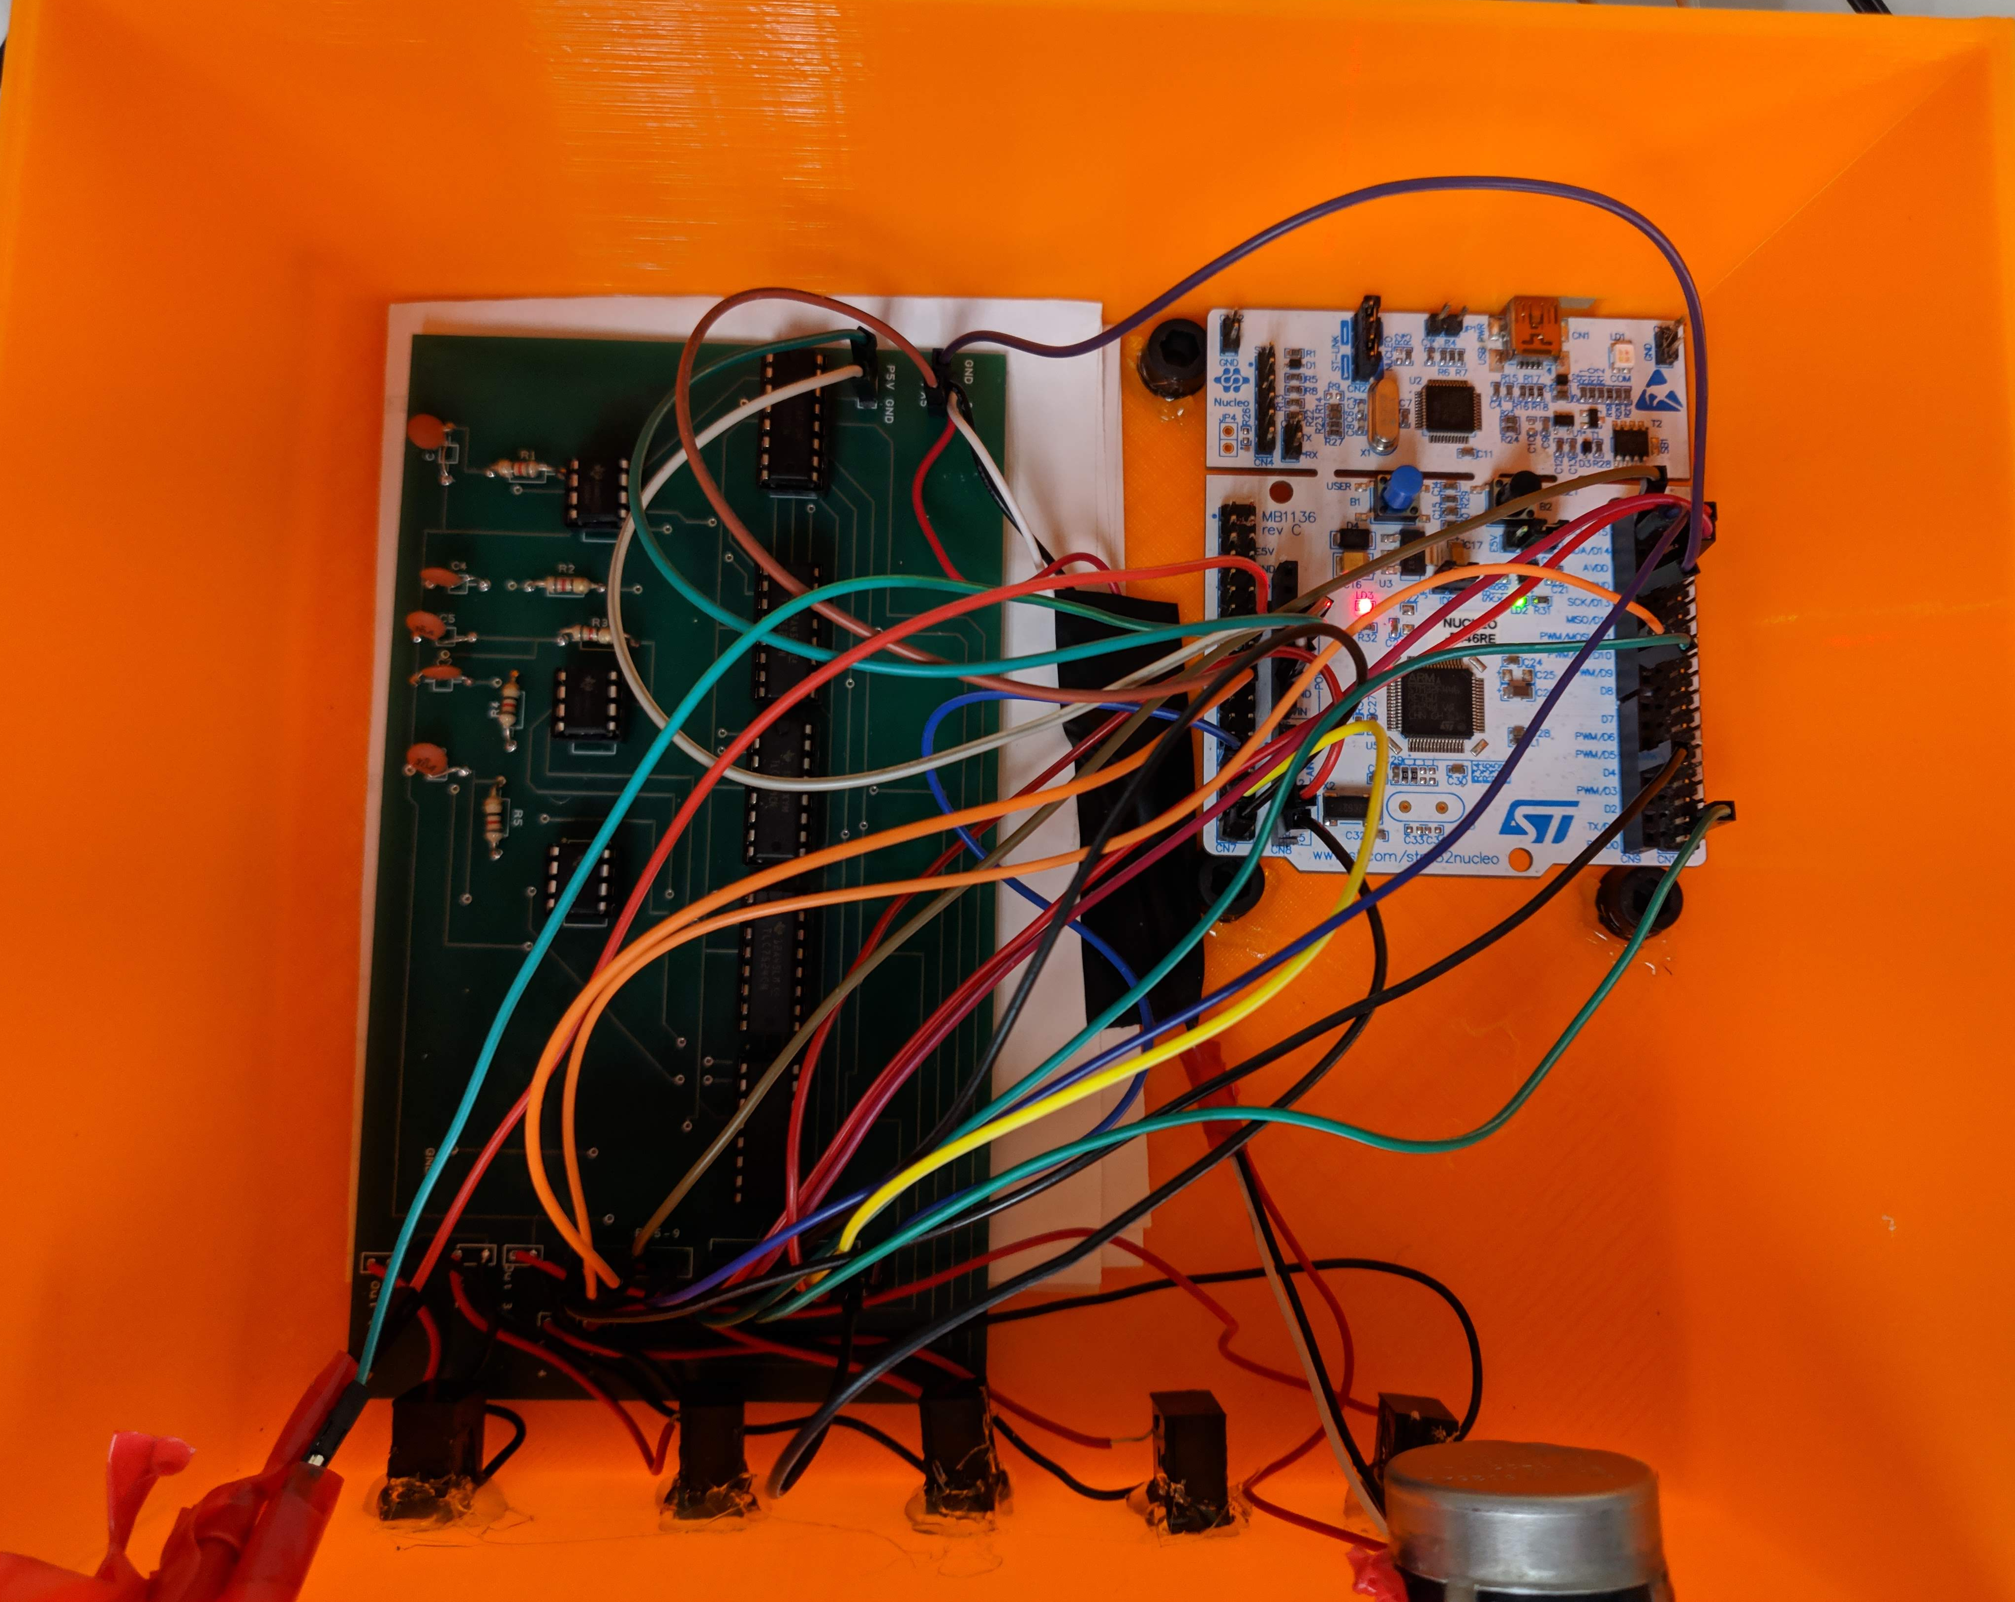
Phased Array in Sound
Austin Brummett, EE
Advisor: Dr. Blandford
Abstract
The phased array in sound generates a tone via the STM32F446RE microcontroller that can be phased adjusted by the user through a potentiometer. This creates a sense of directional sound outputting from a line array of speakers which is useful in demonstrating how a phased array system works. Applications of phased arrays are found in many places, such as broadcasting, radar systems, and ultrasonics.
Software Flow Chart
Features
Approximately 1kHz 8-bit sinusoidal output tone sampled at 44.1kHz via a Timer Interrupt
Works with any five speakers with internal input amplifiers and a 3.5mm jack.
Adjustable by potentiometer.
Final Design
Hardware Flow Chart
Final Results
This project is tested by having a listener walk across the array to detect a change in the direction of the sound.
An oscilloscope was used to prove that the sine waves are phase shifted.

